Slide 1
SC2001/CE2101/ CZ2101: Algorithm Design and Analysis
Union-Find Programs and
Kruskal’s Algorithm
Instructor: Asst. Prof. LIN Shang-Wei
Courtesy of Dr. Ke Yiping, Kelly’s slides
Notes:
This set of slides were produced based on Prof. Robert Sedgewick’s slides at Princeton University.

Slide 2
Contents
Dynamic Equivalence Relations
  Three basic operations
Union-Find Programs
  Improve algorithms step by step
    QuickFind
    QuickUnion
    Weighted QuickUnion with Path Compression (WQUPC)
Kruskal’s Algorithm
  Pseudocode
  Correctness
  Complexity

Slide 3
Learning Objectives
  At the end of this lecture, students should be able to:
  Understand the concept of dynamic equivalence relations
  Understand and analyze various union-find programs
  Solve minimum spanning tree (MST) problem using Kruskal’s algorithm
  Prove the correctness of Kruskal’s algorithm

Slide 4
Dynamic Equivalence Relations

Slide 5
Dynamic Equivalence Relations
An equivalence relation R on a set S is a binary relation, such that for every a, b, and c in S:
  Reflexivity: R(a, a)
  Symmetry: if R(a, b), then R(b, a)
  Transitivity: if R(a, b) and R(b, c), then R(a, c)
Dynamic equivalence relation: the equivalence relation will change with a number of operations
Given a set of N objects in S, define three operations:
  Initialize the objects
  Connect two objects: add them into relation R
  Is there a path connecting two objects?

Slide 6
Running Example
Initialize 8 objects: 0, …, 7
Connect 4 and 5
Connect 1 and 2
Connect 6 and 3
Connect 0 and 4
Are 1 and 7 connected?
Are 0 and 5 connected?
Connect 2 and 6
Connect 3 and 7
Are 1 and 7 connected?
0
1
2
3
✗
4
5
6
7
✓
✓

Slide 7
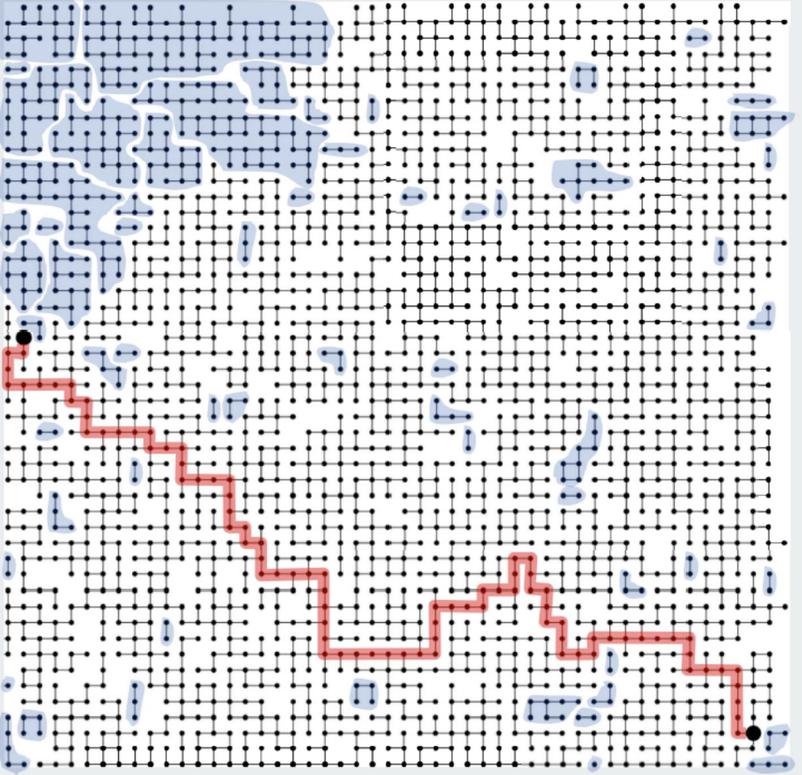
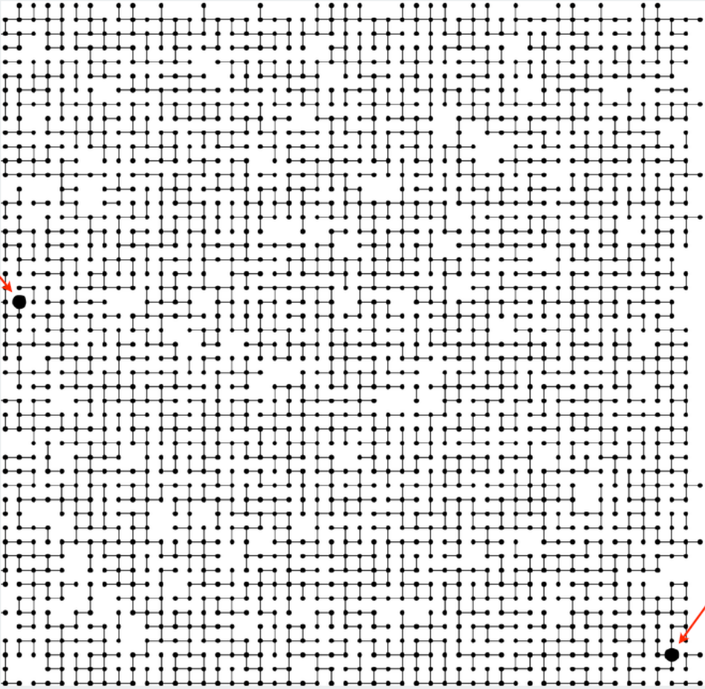
A Larger Example
Are the two big dots connected?
Yes
63 components

Slide 8
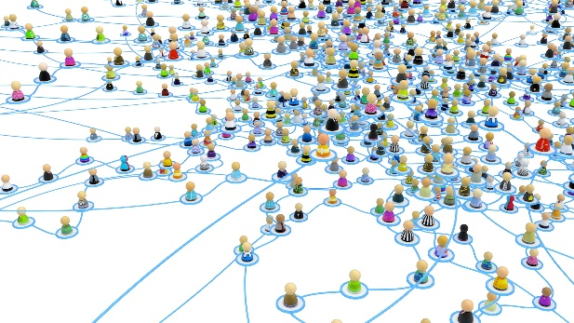

Applications
Friends in a social network
Webpages on the Internet
Statements in a Python program
Computers in a computer network
Transistors in a computer chip

Slide 9
Challenges
Dynamics:
  Operations may be intermixed.
Number of operations M can be huge.
Number of objects N can be huge.
Goal: design efficient data structure

Slide 10
Union-Find Programs

Slide 11
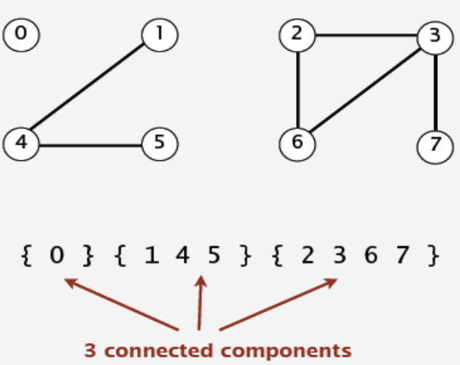
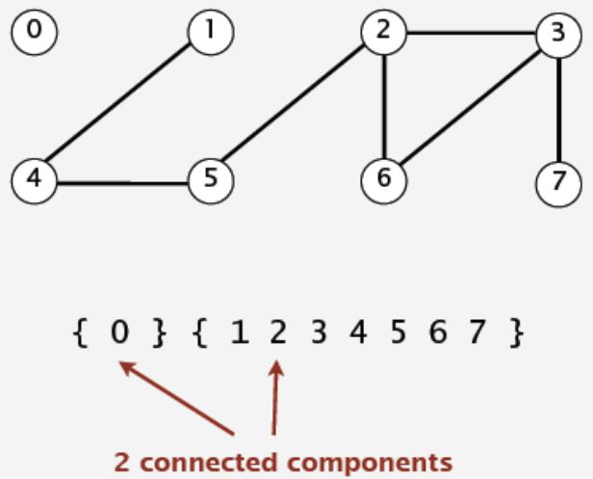
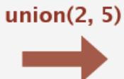
Union-Find
Equivalence class: connected components
Three operations to implement the dynamic equivalence relation
  find(p): which component does an object p belong to?
  connected(p, q): are two objects p and q connected?
  union(p, q): connect p and q (compute the union of their components)

Slide 12
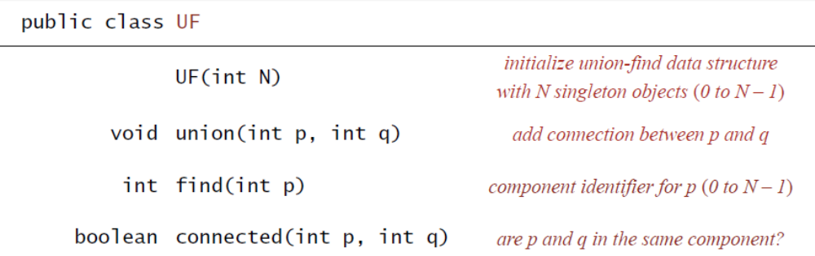
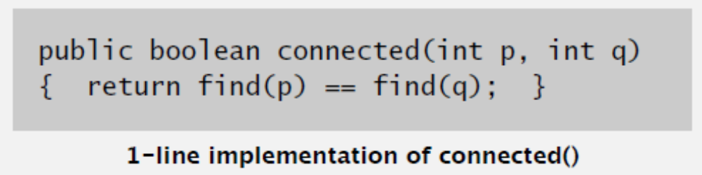
Union-Find APIs
A class defined for union-find (in Java)

Slide 13
QuickFind Algorithm

Slide 14
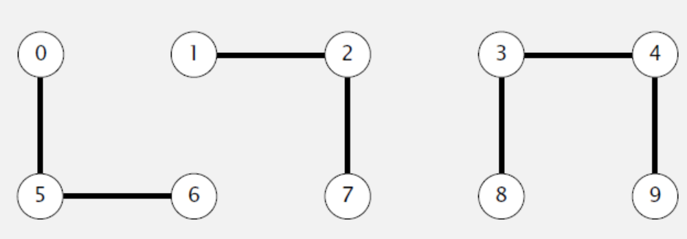
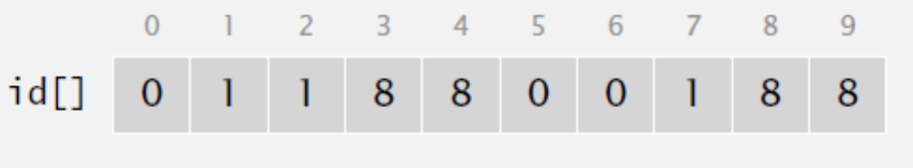
QuickFind [Eager Approach]
Data structure:
  Integer array id[ ] of length N
  Interpretation: id[p] is the ID of the component that p belongs to

Slide 15
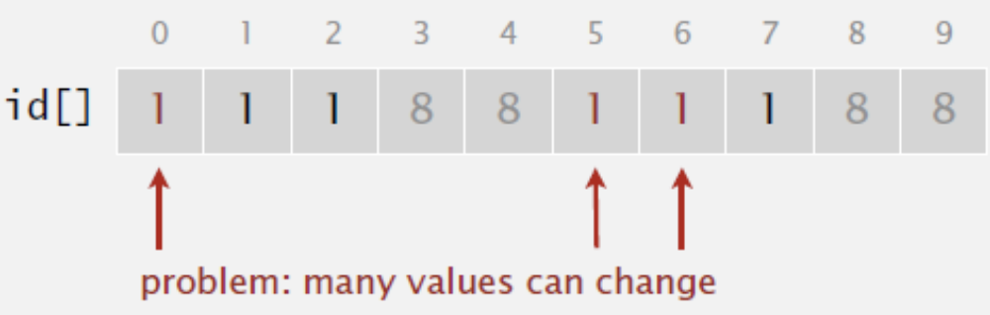
QuickFind Functions
find(p): what is the id of p?
  id[6] = 0; id[1] = 1
connected(p, q): do p and q have the same id?
  6 and 1 are not connected
union(p, q): change all entries whose id equals id[p] to id[q]
  union(6, 1)
$$id\left[x\right]←id\left[q\right], ∀x. id\left[x\right]=id[p]$$

Slide 16
QuickFind Demo
0
1
2
3
4
5
6
7
8
9
0 | 1 | 2 | 3 | 4 | 5 | 6 | 7 | 8 | 9
id
0 | 1 | 2 | 3 | 4 | 5 | 6 | 7 | 8 | 9

Slide 17
QuickFind Demo
union(4, 3)
$$id\left[x\right]←id\left[3\right], ∀x. id\left[x\right]=id[4]$$
0
1
2
3
4
5
6
7
8
9
0 | 1 | 2 | 3 | 4 | 5 | 6 | 7 | 8 | 9
0 | 1 | 2 | 3 | 4 | 5 | 6 | 7 | 8 | 9
id
3

Slide 18
QuickFind Demo
union(3, 8)
$$id\left[x\right]←id\left[8\right], ∀x. id\left[x\right]=id[3]$$
0
1
2
3
4
5
6
7
8
9
0 | 1 | 2 | 3 | 4 | 5 | 6 | 7 | 8 | 9
0 | 1 | 2 | 3 | 3 | 5 | 6 | 7 | 8 | 9
id
8
8

Slide 19
QuickFind Demo
union(6, 5)
$$id\left[x\right]←id\left[5\right], ∀x. id\left[x\right]=id[6]$$
0
1
2
3
4
5
6
7
8
9
0 | 1 | 2 | 3 | 4 | 5 | 6 | 7 | 8 | 9
0 | 1 | 2 | 8 | 8 | 5 | 6 | 7 | 8 | 9
id
5

Slide 20
QuickFind Demo
union(9, 4)
$$id\left[x\right]←id\left[4\right], ∀x. id\left[x\right]=id[9]$$
0
1
2
3
4
5
6
7
8
9
0 | 1 | 2 | 3 | 4 | 5 | 6 | 7 | 8 | 9
0 | 1 | 2 | 8 | 8 | 5 | 5 | 7 | 8 | 9
id
8

Slide 21
QuickFind Demo
union(2, 1)
$$id\left[x\right]←id\left[1\right], ∀x. id\left[x\right]=id[2]$$
0
1
2
3
4
5
6
7
8
9
0 | 1 | 2 | 3 | 4 | 5 | 6 | 7 | 8 | 9
0 | 1 | 2 | 8 | 8 | 5 | 5 | 7 | 8 | 8
id
1

Slide 22
QuickFind Demo
connected(8, 9)
0
1
2
3
4
5
6
7
8
9
0 | 1 | 2 | 3 | 4 | 5 | 6 | 7 | 8 | 9
id
0 | 1 | 1 | 8 | 8 | 5 | 5 | 7 | 8 | 8
Connected

Slide 23
QuickFind Demo
connected(5, 0)
0
1
2
3
4
5
6
7
8
9
0 | 1 | 2 | 3 | 4 | 5 | 6 | 7 | 8 | 9
id
0 | 1 | 1 | 8 | 8 | 5 | 5 | 7 | 8 | 8
Not connected

Slide 24
QuickFind Demo
union(5, 0)
$$id\left[x\right]←id\left[0\right], ∀x. id\left[x\right]=id[5]$$
0
1
2
3
4
5
6
7
8
9
0 | 1 | 2 | 3 | 4 | 5 | 6 | 7 | 8 | 9
0 | 1 | 1 | 8 | 8 | 5 | 5 | 7 | 8 | 8
id
0
0

Slide 25
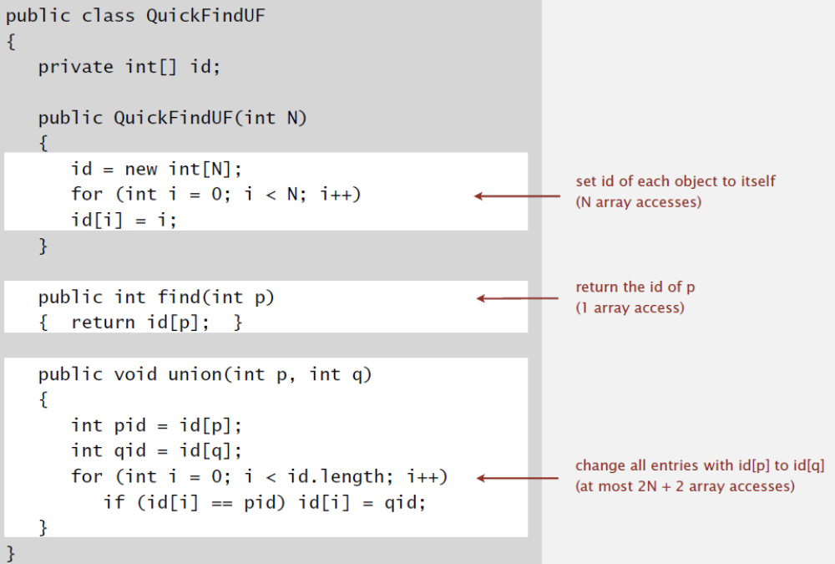
QuickFind Implementation (Java)

Slide 26
QuickFind - Time Complexity
Measured by: number of array accesses (read or write)
union() is too expensive:
  For N union operations on N objects, it takes O(N²) time.
Algorithm | Initialization | union | find | connected
QuickFind | O(N) | O(N) | O(1) | O(1)

Slide 27
Quadratic is not scalable
Rough standard (in 2020)
  10¹¹ operations per second
  10¹¹ words of main memory (400GB)
  Access all words in ~1 second
Huge problem for QuickFind
  10¹¹ union operations on 10¹¹ objects
  QuickFind takes more than 10²² operations.
  3000+ years to complete!
Quadratic algorithms don’t scale with technology
  We need better algorithms!

Slide 28
QuickUnion Algorithm

Slide 29
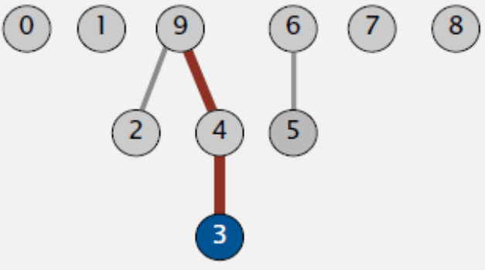
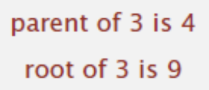
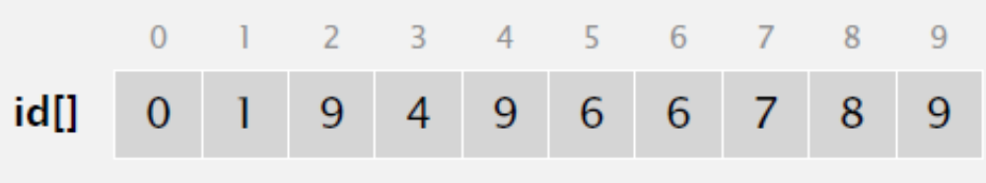
QuickUnion [Lazy Approach]
Data structure:
  Integer array id[ ] of length N
  Interpretation: id[p] is the parent of p
  Root of p is id[id[id[…id[i]…]]]: component ID
    Keep id-ing until the value doesn’t change (cycles?)

Slide 30
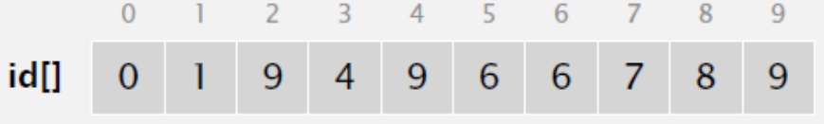
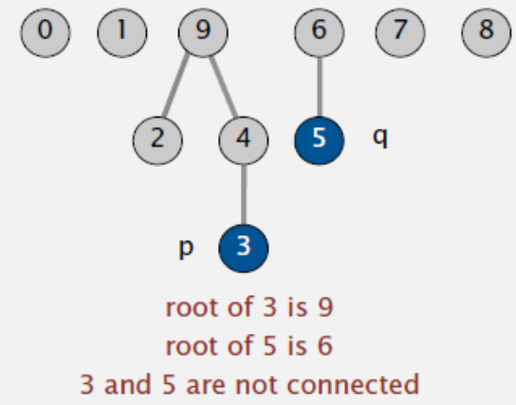
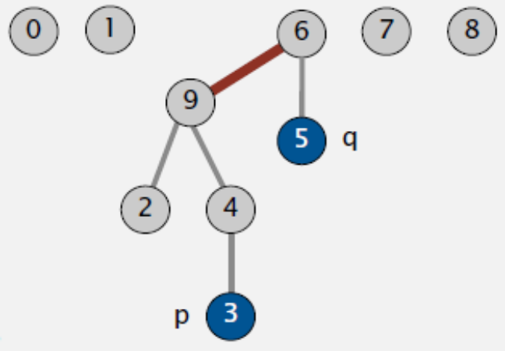
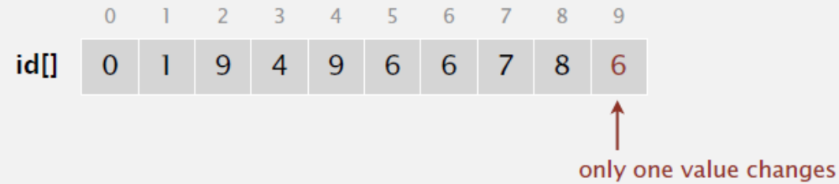
QuickUnion Functions
find(p):
  what is the root of p?
connected(p, q):
  do p and q have the same root?
union(p, q):
  set the id of p’s root to the id of q’s root.
id[root(p)] ← root(q)
E.g., union(3, 5)

Slide 31
QuickUnion Demo
0
1
2
3
4
5
6
7
8
9
0 | 1 | 2 | 3 | 4 | 5 | 6 | 7 | 8 | 9
id
0 | 1 | 2 | 3 | 4 | 5 | 6 | 7 | 8 | 9

Slide 32
QuickUnion Demo
union(4, 3)
id[root(4)] ← root(3)
0
1
2
3
4
5
6
7
8
9
0 | 1 | 2 | 3 | 4 | 5 | 6 | 7 | 8 | 9
0 | 1 | 2 | 3 | 4 | 5 | 6 | 7 | 8 | 9
id
3

Slide 33
QuickUnion Demo
union(3, 8)
id[root(3)] ← root(8)
0
1
2
3
5
6
7
8
9
4
0 | 1 | 2 | 3 | 4 | 5 | 6 | 7 | 8 | 9
0 | 1 | 2 | 3 | 3 | 5 | 6 | 7 | 8 | 9
id
8

Slide 34
QuickUnion Demo
union(6, 5)
id[root(6)] ← root(5)
0
1
2
5
6
7
8
9
3
4
0 | 1 | 2 | 3 | 4 | 5 | 6 | 7 | 8 | 9
0 | 1 | 2 | 8 | 3 | 5 | 6 | 7 | 8 | 9
id
5

Slide 35
QuickUnion Demo
union(9, 4)
id[root(9)] ← root(4)
0
1
2
5
7
8
9
6
3
4
0 | 1 | 2 | 3 | 4 | 5 | 6 | 7 | 8 | 9
0 | 1 | 2 | 8 | 3 | 5 | 5 | 7 | 8 | 9
id
8

Slide 36
QuickUnion Demo
union(2, 1)
id[root(2)] ← root(1)
0
1
2
5
7
8
6
3
9
4
0 | 1 | 2 | 3 | 4 | 5 | 6 | 7 | 8 | 9
1
id
0 | 1 | 2 | 8 | 3 | 5 | 5 | 7 | 8 | 8

Slide 37
QuickUnion Demo
connected(8, 9)
✓
0
1
5
7
8
2
6
3
9
4
0 | 1 | 2 | 3 | 4 | 5 | 6 | 7 | 8 | 9
id
0 | 1 | 1 | 8 | 3 | 5 | 5 | 7 | 8 | 8

Slide 38
QuickUnion Demo
connected(5, 4)
✗
0
1
5
7
8
2
6
3
9
4
0 | 1 | 2 | 3 | 4 | 5 | 6 | 7 | 8 | 9
id
0 | 1 | 1 | 8 | 3 | 5 | 5 | 7 | 8 | 8

Slide 39
QuickUnion Demo
union(5, 0)
id[root(5)] ← root(0)
0
1
5
7
8
2
6
3
9
4
0 | 1 | 2 | 3 | 4 | 5 | 6 | 7 | 8 | 9
0
id
0 | 1 | 1 | 8 | 3 | 5 | 5 | 7 | 8 | 8

Slide 40
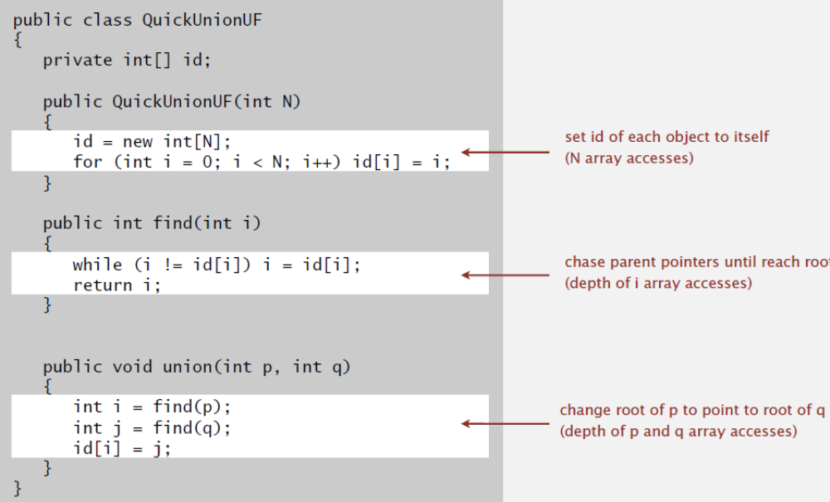
QuickUnion Implementation (Java)

Slide 41
QuickUnion - Time Complexity
Measured by: number of array accesses (read or write)
QuickFind:
  union() is too expensive.
  Trees are flat, but need many id updates to keep them flat
QuickUnion:
  Trees can be tall.
  find() and connected() are too expensive.
Algorithm | Initialization | union | find | connected
QuickFind | O(N) | O(N) | O(1) | O(1)
QuickUnion | O(N) | O(N) | O(N) | O(N)
worst
case

Slide 42
WQUPC Algorithm

Slide 43
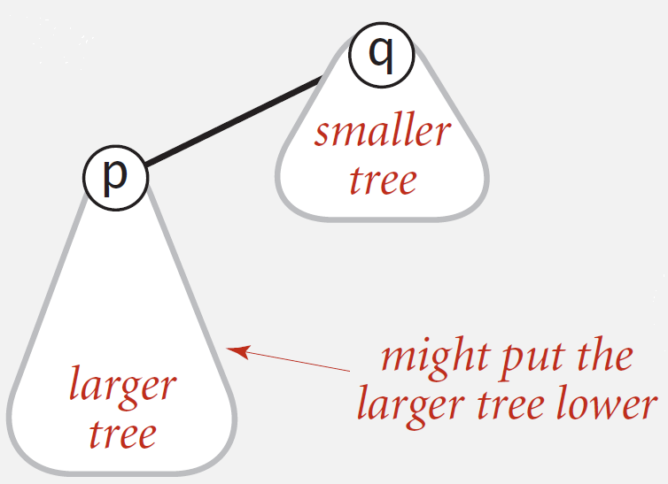
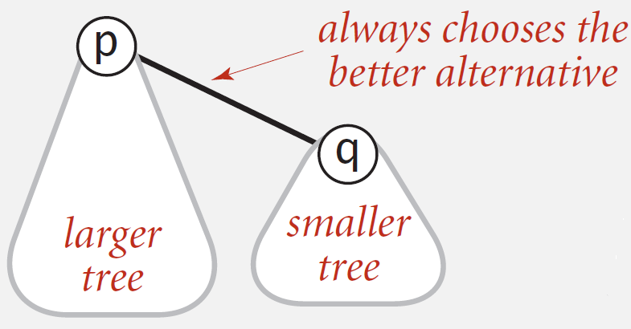
1. Weighted QuickUnion
Idea:
  Modify QuickUnion to avoid tall trees.
  Keep track of size of each tree (number of objects).
  Balance by linking root of smaller tree to root of larger tree.
  Other alternatives: ?
When performing union() operations
QuickUnion
Weighted QuickUnion

Slide 44
Weighted QuickUnion Demo
0
1
2
3
4
5
6
7
8
9
0 | 1 | 2 | 3 | 4 | 5 | 6 | 7 | 8 | 9
id
0 | 1 | 2 | 3 | 4 | 5 | 6 | 7 | 8 | 9

Slide 45
Weighted QuickUnion Demo
union(4, 3)
0
1
2
3
4
5
6
7
8
9
0 | 1 | 2 | 3 | 4 | 5 | 6 | 7 | 8 | 9
0 | 1 | 2 | 3 | 4 | 5 | 6 | 7 | 8 | 9
id
4

Slide 46
Weighted QuickUnion Demo
union(3, 8)
0
1
2
4
5
6
7
8
9
3
Weighting makes 8 point to 4
0 | 1 | 2 | 3 | 4 | 5 | 6 | 7 | 8 | 9
0 | 1 | 2 | 4 | 4 | 5 | 6 | 7 | 8 | 9
id
4

Slide 47
Weighted QuickUnion Demo
union(6, 5)
0
1
2
4
5
6
7
9
3
8
0 | 1 | 2 | 3 | 4 | 5 | 6 | 7 | 8 | 9
0 | 1 | 2 | 4 | 4 | 5 | 6 | 7 | 4 | 9
id
6

Slide 48
Weighted QuickUnion Demo
union(9, 4)
0
1
2
4
6
7
9
3
8
5
Weighting makes 9 point to 4
0 | 1 | 2 | 3 | 4 | 5 | 6 | 7 | 8 | 9
0 | 1 | 2 | 4 | 4 | 6 | 6 | 7 | 4 | 9
id
4

Slide 49
Weighted QuickUnion Demo
union(2, 1)
0
1
2
4
6
7
3
8
9
5
0 | 1 | 2 | 3 | 4 | 5 | 6 | 7 | 8 | 9
0 | 1 | 2 | 4 | 4 | 6 | 6 | 7 | 4 | 4
id
2

Slide 50
Weighted QuickUnion Demo
union(5, 0)
0
2
4
6
7
1
3
8
9
5
Weighting makes 0 point to 6
0 | 1 | 2 | 3 | 4 | 5 | 6 | 7 | 8 | 9
0 | 2 | 2 | 4 | 4 | 6 | 6 | 7 | 4 | 4
id
6

Slide 51
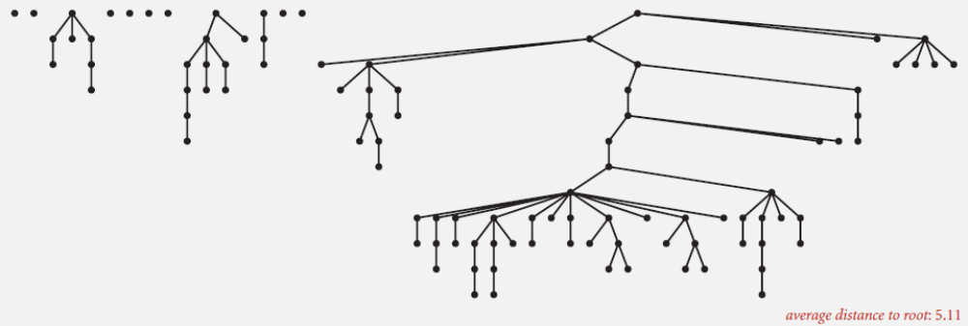
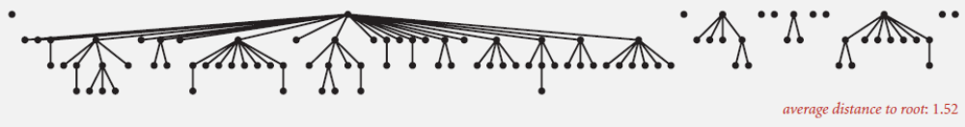
QuickUnion vs Weighted QuickUnion
On 100 objects, 88 union operations
QuickUnion
Weighted QuickUnion

Slide 52
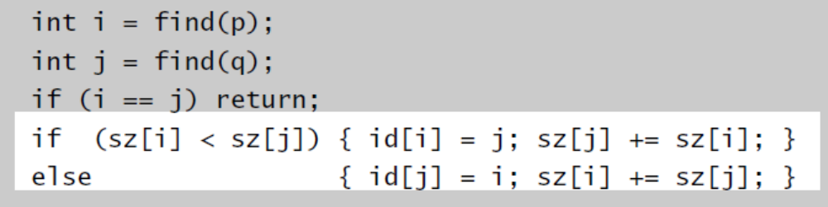
Weighted QuickUnion Implementation
Data structure:
  Extra array sz[i] to count no. of objects in the tree rooted at i.
find() and connect()
  Same as QuickUnion
union(p,q)
  Make smaller tree lower
  Update the array sz[ ]

Slide 53
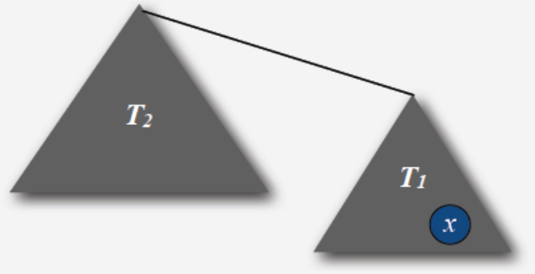
Weighted QuickUnion - Time Complexity
Running time depends on the depth of a node.
Proposition. Depth of any node x is at most log₂N.
Proof:
  What causes the depth of a node x to increase?
  Increases by 1 when tree T₁ containing x is merged into another tree T₂
    Size of the tree containing x at least doubles since |T₂| ≥ |T₁|
    Size of the tree containing x can double at most log₂N times. (?)

Slide 54
Weighted QuickUnion - Time Complexity
Running time depends on the depth of a node.
Proposition. Depth of any node x is at most log₂N.
Stop here??
  No, easy to improve further.
Algorithm | Initialization | union | find | connected
QuickFind | O(N) | O(N) | O(1) | O(1)
QuickUnion | O(N) | O(N) | O(N) | O(N)
Weighted QuickUnion | O(N) | O(log N) | O(log N) | O(log N)

Slide 55
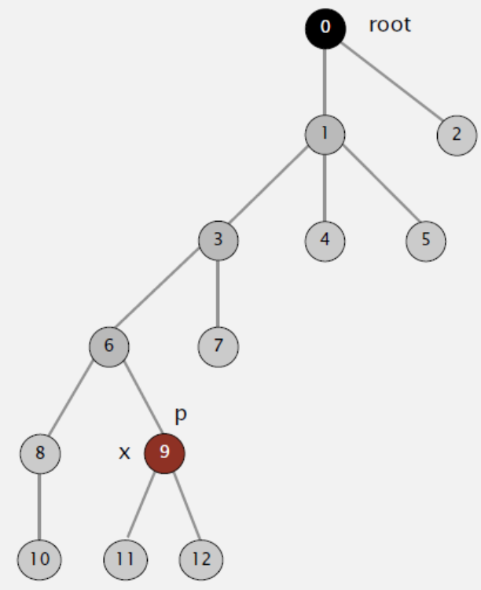
2. Weighted QuickUnion with Path Compression
When performing find(), compress the paths!!
Idea:
  Right after computing the root of p, set the id[ ] of each node on the path to that root

Slide 56
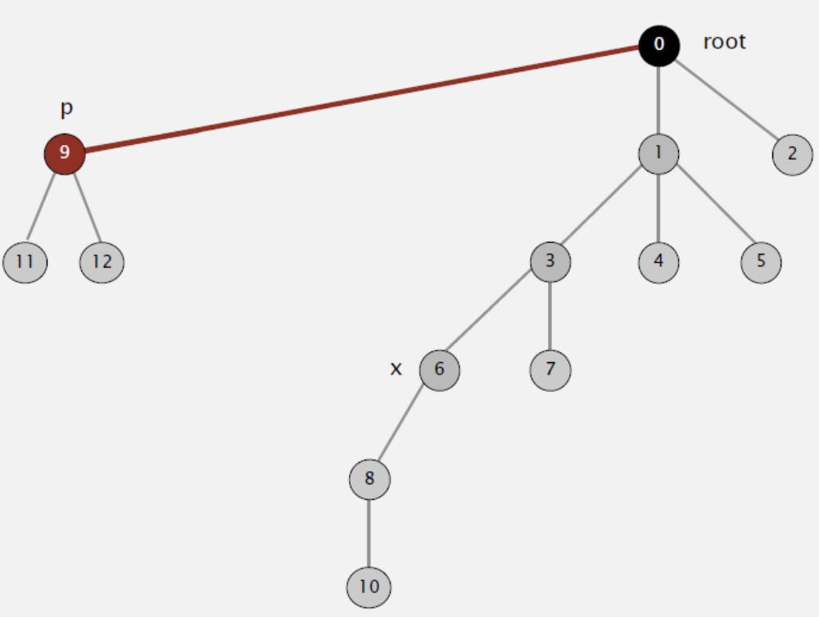
2. Weighted QuickUnion with Path Compression
When performing find(), compress the paths!!
Idea:
  Right after computing the root of p, set the id[ ] of each node on the path to that root

Slide 57
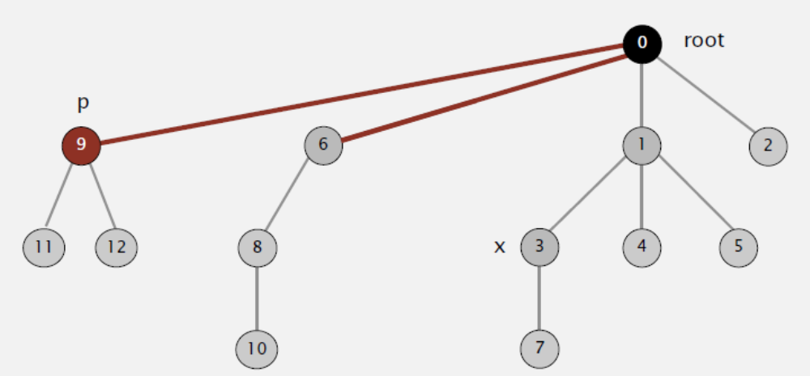
2. Weighted QuickUnion with Path Compression
When performing find(), compress the paths!!
Idea:
  Right after computing the root of p, set the id[ ] of each node on the path to that root

Slide 58
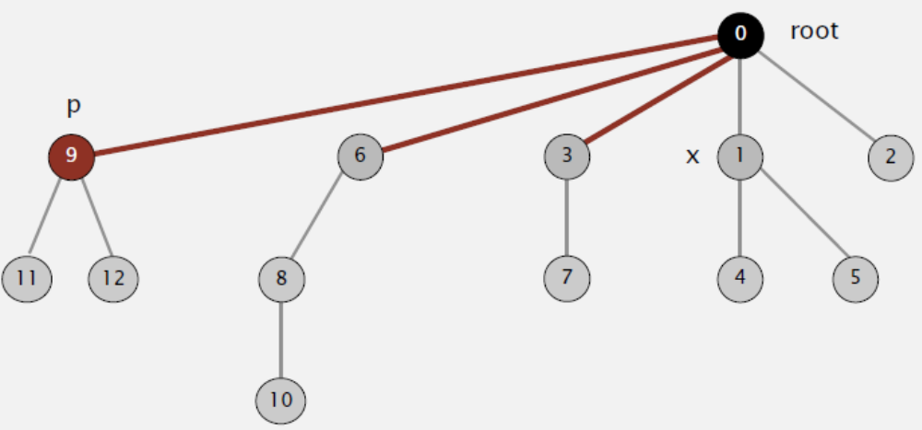
2. Weighted QuickUnion with Path Compression
When performing find(), compress the paths!!
Idea:
  Right after computing the root of p, set the id[ ] of each node on the path to that root

Slide 59
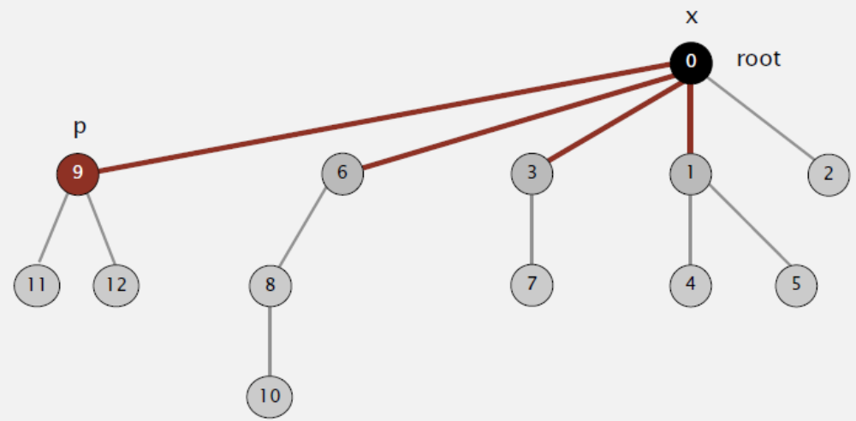
2. Weighted QuickUnion with Path Compression
When performing find(), compress the paths!!
Idea:
  Right after computing the root of p, set the id[ ] of each node on the path to that root

Slide 60
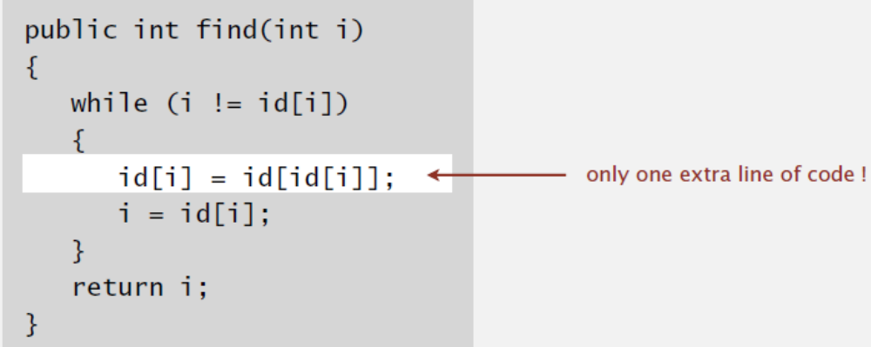
WQUPC Implementation (Java)
Two-pass implementation
  Add second loop to find() to set the id[ ] of each examined node to the root. (As in previous example)
Simpler one-pass variant (path halving)
  Make every other node in path point to its grandparent
In practice: keeps tree almost completely flat

Slide 61
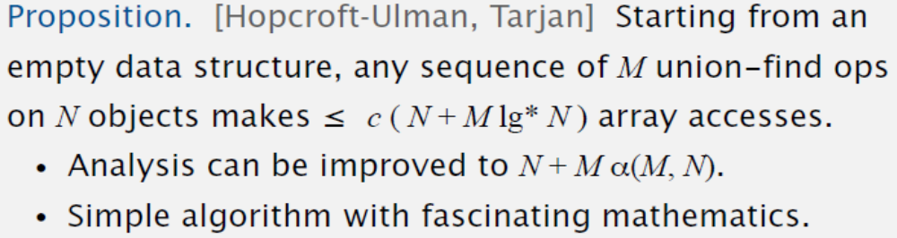
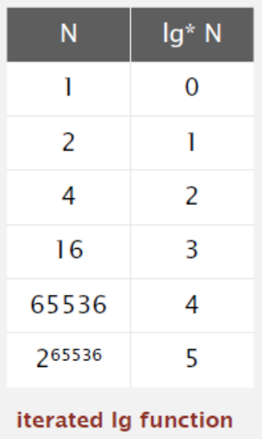
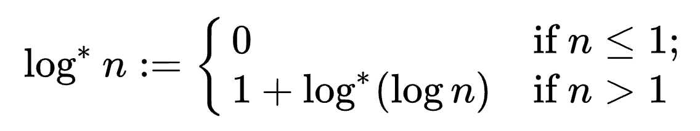
WQUPC: Time Complexity
[Fredman-Saks] No linear-time algorithm exists.
WQUPC:
  In theory: not quite linear
  In practice: linear

Slide 62
Summary: Union-Find
Weighted QuickUnion (w/wo path compression) makes it possible to solve problems that could not otherwise be addressed.
Complexity for M union-find operations on N objects
[10¹¹ unions with 10¹¹ objects]
  WQUPC reduces time from 3000 years to 6 seconds
  Supercomputer won’t help much; good algorithm makes it feasible!
Algorithms | Worst-Case Time
QuickFind | M N
QuickUnion | M N
Weighted QuickUnion | N + M logN
Weighted QuickUnion with Path Compression | N + M log*N

Slide 63
Kruskal’s Algorithm

Slide 64
Kruskal’s Algorithm
To compute the minimum spanning tree (MST)
Uses the greedy strategy
Main Idea:
  Consider edges in increasing order of weight
  Add next edge to tree T unless it would create a cycle

Slide 65
Kruskal’s Algorithm - Example
Graph edges in weight increasing order
edge
weight
0-7 0.16
2-3 0.17
1-7 0.19
1
3
0-2 0.26
5-7 0.28
5
1-3 0.29
2
1-5 0.32
7
2-7 0.34
0
4-5 0.35
1-2 0.36
4
6
4-7 0.37
0-4 0.38
6-2 0.40
3-6 0.52
6-0 0.58
6-4 0.93

Slide 66
Kruskal’s Algorithm - Example
Graph edges in weight increasing order
edge
weight
0-7 0.16
2-3 0.17
1-7 0.19
1
3
0-2 0.26
5-7 0.28
5
1-3 0.29
2
1-5 0.32
7
2-7 0.34
0
4-5 0.35
1-2 0.36
4
6
4-7 0.37
0-4 0.38
6-2 0.40
3-6 0.52
6-0 0.58
6-4 0.93

Slide 67
Kruskal’s Algorithm - Example
Graph edges in weight increasing order
edge
weight
0-7 0.16
2-3 0.17
1-7 0.19
1
3
0-2 0.26
5-7 0.28
5
1-3 0.29
2
1-5 0.32
7
2-7 0.34
0
4-5 0.35
1-2 0.36
4
6
4-7 0.37
0-4 0.38
6-2 0.40
3-6 0.52
6-0 0.58
6-4 0.93

Slide 68
Kruskal’s Algorithm - Example
Graph edges in weight increasing order
edge
weight
0-7 0.16
2-3 0.17
1-7 0.19
1
3
0-2 0.26
5-7 0.28
5
1-3 0.29
2
1-5 0.32
7
2-7 0.34
0
4-5 0.35
1-2 0.36
4
6
4-7 0.37
0-4 0.38
6-2 0.40
3-6 0.52
6-0 0.58
6-4 0.93

Slide 69
Kruskal’s Algorithm - Example
Graph edges in weight increasing order
edge
weight
0-7 0.16
2-3 0.17
1-7 0.19
1
3
0-2 0.26
5-7 0.28
5
1-3 0.29
2
1-5 0.32
7
2-7 0.34
0
4-5 0.35
1-2 0.36
4
6
4-7 0.37
0-4 0.38
6-2 0.40
3-6 0.52
6-0 0.58
6-4 0.93

Slide 70
Kruskal’s Algorithm - Example
Graph edges in weight increasing order
edge
weight
0-7 0.16
2-3 0.17
1-7 0.19
1
3
0-2 0.26
5-7 0.28
5
1-3 0.29
2
1-5 0.32
7
2-7 0.34
0
4-5 0.35
1-2 0.36
4
6
4-7 0.37
0-4 0.38
6-2 0.40
3-6 0.52
6-0 0.58
6-4 0.93

Slide 71
Kruskal’s Algorithm - Example
Graph edges in weight increasing order
edge
weight
0-7 0.16
2-3 0.17
✗, cycle
1-7 0.19
1
3
0-2 0.26
5-7 0.28
5
1-3 0.29
2
1-5 0.32
7
2-7 0.34
0
4-5 0.35
1-2 0.36
4
6
4-7 0.37
0-4 0.38
6-2 0.40
3-6 0.52
6-0 0.58
6-4 0.93

Slide 72
Kruskal’s Algorithm - Example
Graph edges in weight increasing order
edge
weight
0-7 0.16
2-3 0.17
✗, cycle
1-7 0.19
1
3
0-2 0.26
5-7 0.28
5
1-3 0.29
2
1-5 0.32
7
2-7 0.34
0
4-5 0.35
1-2 0.36
4
6
4-7 0.37
0-4 0.38
6-2 0.40
3-6 0.52
6-0 0.58
6-4 0.93

Slide 73
Kruskal’s Algorithm - Example
Graph edges in weight increasing order
edge
weight
0-7 0.16
2-3 0.17
1-7 0.19
1
3
0-2 0.26
5-7 0.28
5
1-3 0.29
✗, cycle
2
1-5 0.32
7
2-7 0.34
0
4-5 0.35
1-2 0.36
4
6
4-7 0.37
0-4 0.38
6-2 0.40
3-6 0.52
6-0 0.58
6-4 0.93

Slide 74
Kruskal’s Algorithm - Example
Graph edges in weight increasing order
edge
weight
0-7 0.16
2-3 0.17
1-7 0.19
1
3
0-2 0.26
5-7 0.28
5
1-3 0.29
2
1-5 0.32
7
2-7 0.34
0
4-5 0.35
1-2 0.36
4
6
4-7 0.37
0-4 0.38
6-2 0.40
3-6 0.52
6-0 0.58
6-4 0.93

Slide 75
Kruskal’s Algorithm - Example
Graph edges in weight increasing order
edge
weight
0-7 0.16
2-3 0.17
1-7 0.19
1
3
0-2 0.26
✗, cycle
5-7 0.28
5
1-3 0.29
2
1-5 0.32
7
2-7 0.34
0
4-5 0.35
1-2 0.36
4
6
4-7 0.37
0-4 0.38
6-2 0.40
3-6 0.52
6-0 0.58
6-4 0.93

Slide 76
Kruskal’s Algorithm - Example
Graph edges in weight increasing order
edge
weight
0-7 0.16
2-3 0.17
1-7 0.19
1
3
0-2 0.26
5-7 0.28
5
1-3 0.29
2
1-5 0.32
7
2-7 0.34
✗, cycle
0
4-5 0.35
1-2 0.36
4
6
4-7 0.37
0-4 0.38
6-2 0.40
3-6 0.52
6-0 0.58
6-4 0.93

Slide 77
Kruskal’s Algorithm - Example
Graph edges in weight increasing order
edge
weight
0-7 0.16
2-3 0.17
1-7 0.19
1
3
0-2 0.26
5-7 0.28
5
1-3 0.29
2
1-5 0.32
7
2-7 0.34
0
4-5 0.35
1-2 0.36
4
6
4-7 0.37
✗, cycle
0-4 0.38
6-2 0.40
3-6 0.52
6-0 0.58
6-4 0.93

Slide 78
Kruskal’s Algorithm - Example
Graph edges in weight increasing order
edge
weight
0-7 0.16
2-3 0.17
1-7 0.19
1
3
0-2 0.26
5-7 0.28
5
1-3 0.29
2
1-5 0.32
7
2-7 0.34
0
4-5 0.35
1-2 0.36
4
6
4-7 0.37
0-4 0.38
6-2 0.40
3-6 0.52
6-0 0.58
6-4 0.93

Slide 79
Kruskal’s Algorithm - Example
Graph edges in weight increasing order
edge
weight
0-7 0.16
2-3 0.17
1-7 0.19
1
3
0-2 0.26
5-7 0.28
5
1-3 0.29
2
1-5 0.32
7
2-7 0.34
0
4-5 0.35
1-2 0.36
4
6
4-7 0.37
0-4 0.38
N-1 edges
Done!
6-2 0.40
3-6 0.52
6-0 0.58
6-4 0.93

Slide 80
Kruskal’s Algorithm: Correctness
Proposition. [Kruskal 1956] Kruskal’s algorithm correctly computes the MST.
Proof by contradiction:
  Suppose the tree T produced by Kruskal’s is not an MST, i.e., it doesn’t satisfy the MST property.
  There is some edge u-v not in T such that adding u-v creates a cycle, in which some other edge x-y has weight W(x-y) > W(u-v).
  As W(x-y) > W(u-v), edge x-y must be processed after edge u-v in Kruskal’s.
  At the time when u-v is processed, it must be added into T because it doesn’t form a cycle.
  This contradicts that u-v is not in T.
x
y
u
v

Slide 81
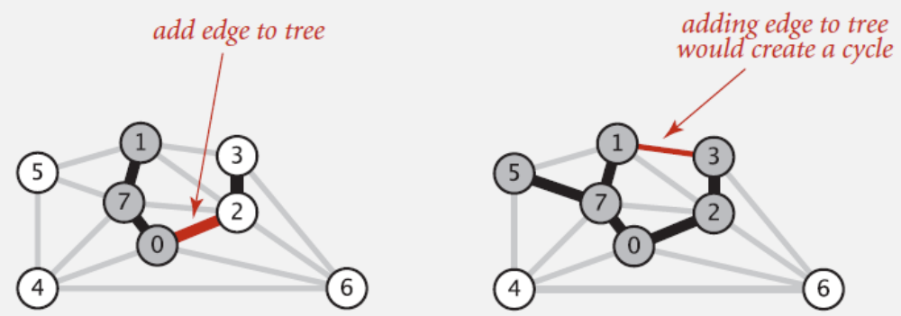
Kruskal’s Algorithm: Implementation
Challenge:
  How to check if adding an edge v-w to tree T will create a cycle?
Possible solutions:
  DFS: run DFS from v to check if it could reach w in T.
  Union-find: connected(v, w) = ?
O(|V|)
O(log* |V|)

Slide 82
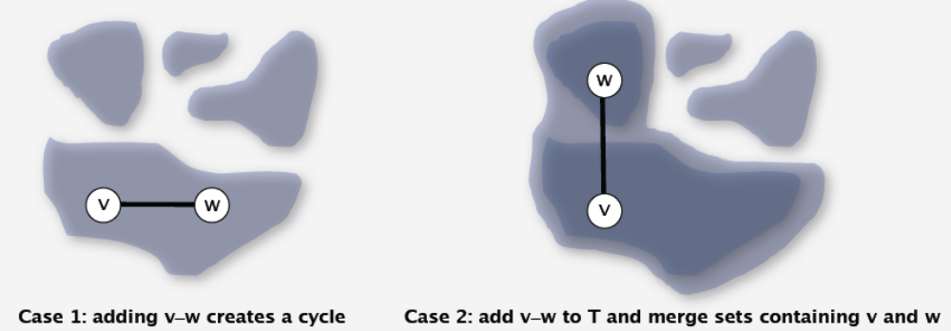
Kruskal’s Algorithm: Implementation
Use the union-find data structure:
  Use the id array to keep track of connected components in T.
  If connected(v, w) = TRUE, then adding v-w will create a cycle.
  Else, add v-w to T by calling union(v, w).

Slide 83
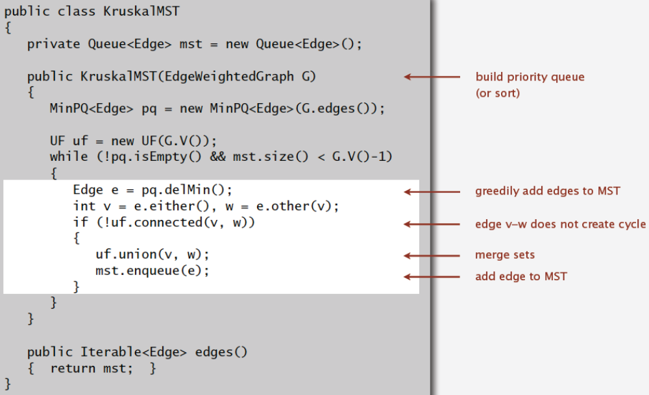
Kruskal’s Algorithm: Implementation (Java)
O(|E|)
O(|V|)
O(|E| log|E|)
O(|E| log*|V|)
O(|V| log*|V|)
O(|V|)
Overall: O(|E| log|E|)

Slide 84
Kruskal’s Algorithm: Summary
Kruskal’s algorithm finds the minimum spanning trees in weighted graphs
It is a greedy algorithm.
It uses the union-find data structure for efficient implementation.
Its time complexity is O(|E| log|E|).

